Slide 1
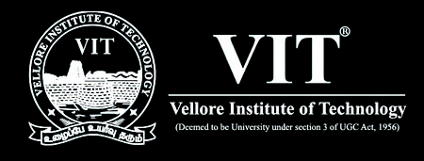
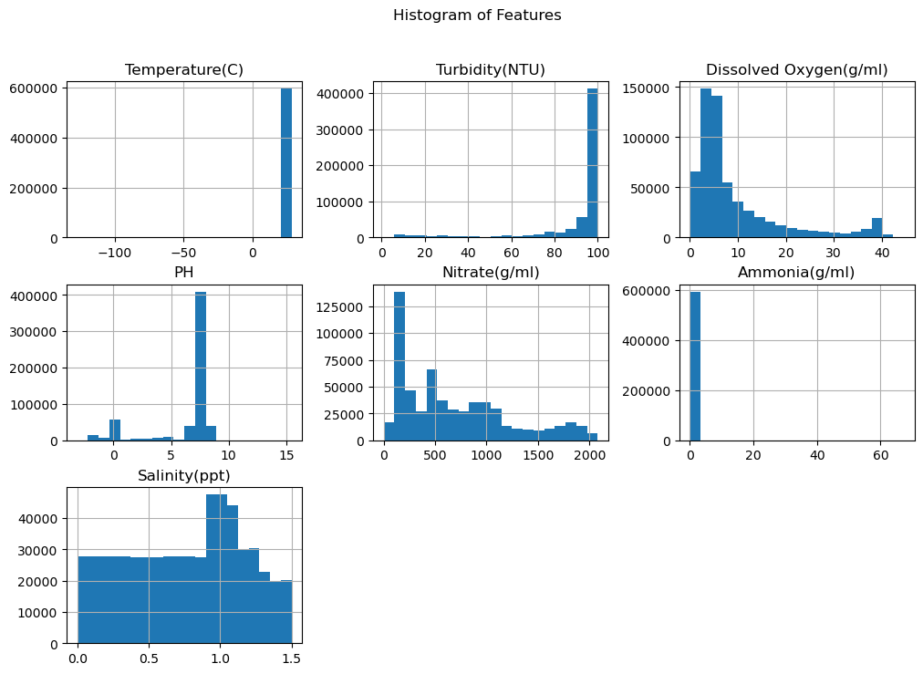
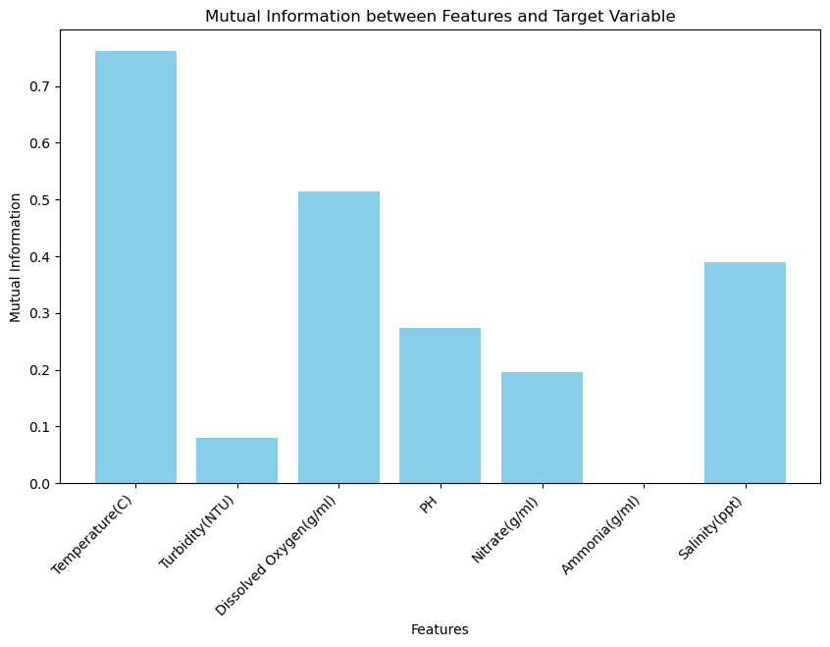
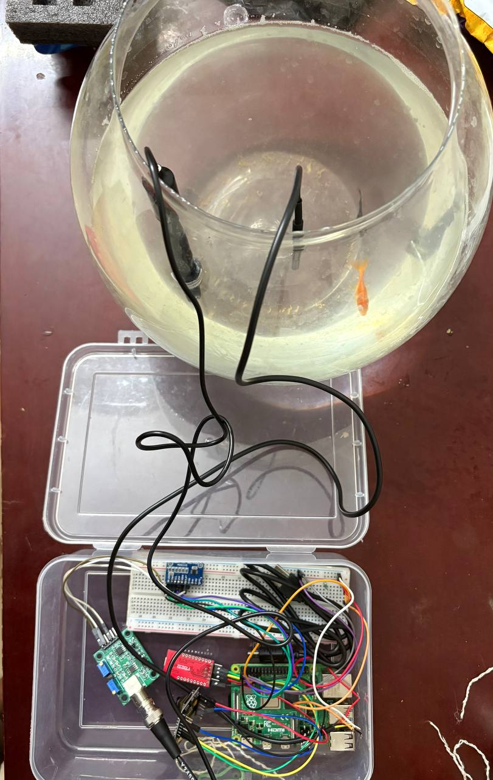

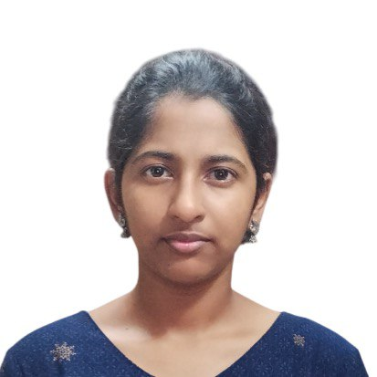
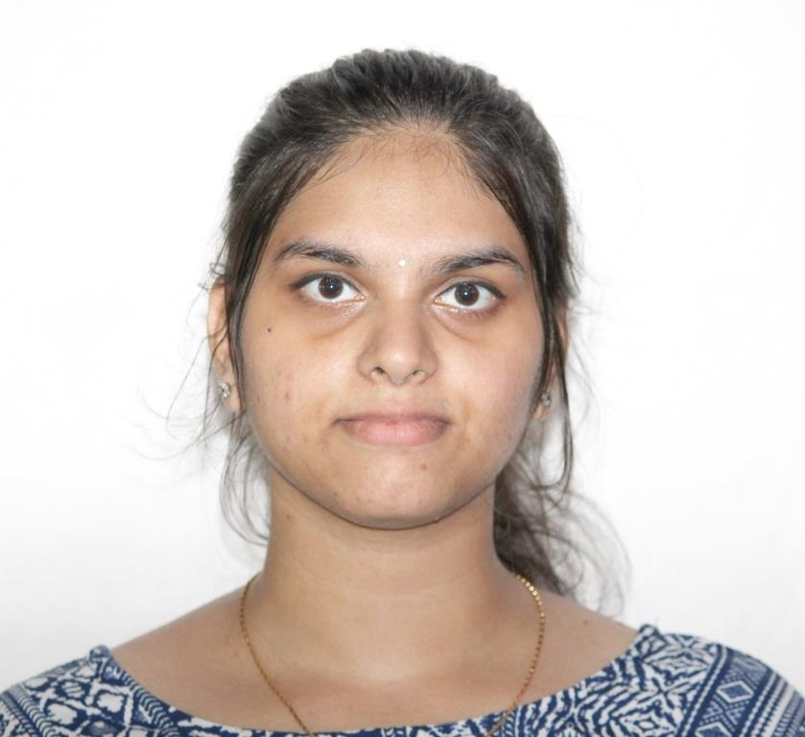

Precision Fish Health: Disease Detection and Water Quality Analysis via ML and IoT
Kalyanasundaram V(21MIS1028),Nikshitha S(21MIS1121), Keerthi AJ(21MIS1055),Madhumitha D(21MIS1148)
Mentor- Dr. Braveen M(SCOPE)
School of Computer Science and Engineering - VIT CHENNAI
INTRODUCTION
Aquaculture is a critical sector for global food security, providing a significant portion of the world's fish supply. Fish diseases pose a major challenge, leading to substantial economic losses and threatening sustainability. Common diseases such as White Spot (Ich), Red Spot, and Fin Rot are often linked to poor water quality, making early detection and prevention essential.
The Challenge: Fish diseases like White Spot, Red Spot, and Fin Rot cause major economic losses in aquaculture.
Our Solution: An intelligent system combining machine learning (CNN & ANN), IoT sensors, and image processing for early disease detection.
Impact: Promotes sustainable aquaculture by reducing losses and improving fish health.
METHODOLOGY
Data Collection: IoT sensors track water quality (temperature, pH, oxygen, etc.); dataset includes fish health indicators.
Preprocessing: Clean data by removing outliers, imputing missing values, and normalizing features.
EDA: Analyze correlations (e.g., turbidity vs. oxygen) and visualize trends.
Model Development: Train CNN for image-based disease detection and ANN for water quality predictions using TensorFlow/Keras.
Real-Time System: Deploy models for live predictions, with alerts via a mobile app or REST API.
Hardware: Use IoT sensors and Raspberry Pi for data collection and processing.
RESULTS AND DISCUSSION
Dataset: Processed 605,373 records, reduced to 601,089 after outlier removal.
Key Insights:High turbidity lowers dissolved oxygen, increasing disease risk.Nitrate and ammonia outliers were critical for accurate predictions.
Model Performance: CNN and ANN achieved high accuracy in classifying diseases.
Impact: Real-time alerts enable farmers to act swiftly, reducing losses.
OBJECTIVES
Early Detection: Accurately identify fish diseases (White Spot, Red Spot,
Fin Rot) at their onset using AI-driven image analysis and water quality correlations.
Continuous Monitoring: Deploy IoT sensors to track critical water parameters (temperature, dissolved oxygen, pH, nitrate, ammonia, turbidity, salinity) 24/7, ensuring proactive health management.
Predictive Analytics: Build robust ML models to forecast disease outbreaks, enabling preventive measures before symptoms escalate.
Farmer Empowerment: Deliver real-time alerts and expert recommendations via a user-friendly mobile app or dashboard, simplifying decision-making.
Sustainability Goal: Minimize environmental impact and economic losses coming under SDG 14 LIFE UNDER WATER, supporting eco-friendly aquaculture practices aligned with global sustainability targets.
CONCLUSION
By enabling early disease detection and real-time water quality monitoring, we empower farmers to protect fish health, cut losses, and embrace sustainability. Future work will expand disease coverage and enhance image processing for broader adoption. Early Disease Detection, Real-Time Water Monitoring
SCOPE OF THE PROJECT
Technological Core: Employs CNN for image-based symptom detection, ANN for water quality-based predictions, and IoT for continuous environmental monitoring.
Practical Applications: Designed for smallholder farms and industrial aquaculture, with a mobile app (Flutter/React Native) and cloud scalability for global deployment.
Limitations Addressed: Restricted to specified diseases; requires high-quality images and reliable sensor data. Future iterations will expand disease coverage and enhance robustness.
Novelty:Oursystem integrates image and environmental data, offering a holistic approach absent in many existing solutions.
Kalyanasundaram V
kalyanasundaram.v2021@vitstudent.ac.in
6381977496
Nikshitha S
nikshitha.s2021@vitstudent.ac.in
9952594184
Keerthi AJ
keerthi.aj2021@vitstudent.ac.in
7904638223
Madhumitha D
madhumitha.d2021@vitstudent.ac.in
9025934377

